Slide 1
CSE 544 Probability and Statistics for Data Science Lecture 1: Intro and Logistics
Instructor: Anshul Gandhi
Department of Computer Science

Slide 2
CSE 544 Probability and Statistics for Data Science
What is Data Science?
Analysis of data (using several tools/techniques)
Statistics/Data Analysis + CS

Slide 3
CSE 544 Probability and Statistics for Data Science
Who is a Data Scientist
Statistics/Data Analysis + CS
Someone who is better at stats than the average CS person
and
someone who is better at CS than an average statistician.

Slide 4
Contact Info:
Anshul Gandhi
347, New CS building
anshul@cs.stonybrook.edu
anshul.gandhi@stonybrook.edu

Slide 5
Outline
Logistics
Course info
Lectures
Office hours
Course webpage + resources
Grading
Syllabus
Tentative schedule

Slide 6
Course Info
Probability theory
Probability review (basics, conditional prob, Bayes’ theorem)
Random variables (mean, variance, Geometric, Normal)
Stochastic processes (Markov chains, …)
Statistical inference
Non-parametric inference (empirical distribution, sample mean, bias, confidence intervals)
Parametric inference (method of moments, max. likelihood)
Hypothesis testing (truth table, various tests, p-values)
DS techniques
Bayesian inference (Bayesian reasoning, conjugate priors)
Regression analysis (linear regression, time series analysis)

Slide 7
Course Info
Prerequisites:
Probability and Statistics
Will greatly help (not necessary)
Basic CS + programming background
We will use Python
This is NOT a systems course
More of a theory + algorithms course

Slide 8


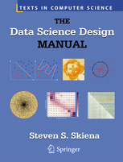

Course Info
Required and recommended texts:
Software:
Available from DoIT

Slide 9
Example 1: Simple stats
X is a collection of 99 integers (positive and negative)
Mean(X) > 0
How many elements of X are > 0?
Same question but now Median(X) > 0?

Slide 10
Lectures
Mon Wed: 2:30pm – 3:50pm
Engineering 143
5-min break at the halfway point
Live slides + annotations
Occasionally some programming (Python)
Posted on website after class
May have cancellations due to weather or unavailability
Will be emailed and updated on website
Weather-related class cancelations decided by SBU

Slide 11
Lectures
Interactive (please)
Will try Echo360 app for quizzes/attendance
Carry a book, a real one!
Please mute your phones
No audio/video recording allowed
On echo (should be available)
Attendance is not mandatory but strongly encouraged
May help to bump your grade if you are on the border

Slide 12
Lectures
Caveat 1: Large class size
Need to engage all
In-class doubts
Caveat 2: iPad + pencil
Be patient

Slide 13
Office hours
Wed 1:30-2:30pm
Thurs 1:30-2:30pm
Will re-visit after add/drop date
Location: CS 347
TA and TA Office hours: TBD
Will have a 1-hour TA OH every week, for assignment help

Slide 14
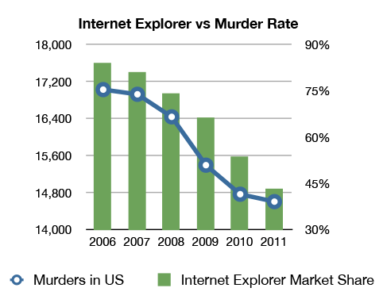
Example 2: Correlation v/s Causation
Q1: Are A and B correlated?
A
B

Slide 15
Example 2: Correlation v/s Causation
Q2: Which of the following is true (i) A causes B
(ii) B causes A
(iii) Either (i) or (ii)
(iv) None of the above
A
B

Slide 16
Example 2: Correlation v/s Causation
Q2: Which of the following is true (i) A causes B
(ii) B causes A
(iii) Either (i) or (ii)
(iv) None of the above
A
B

Slide 17
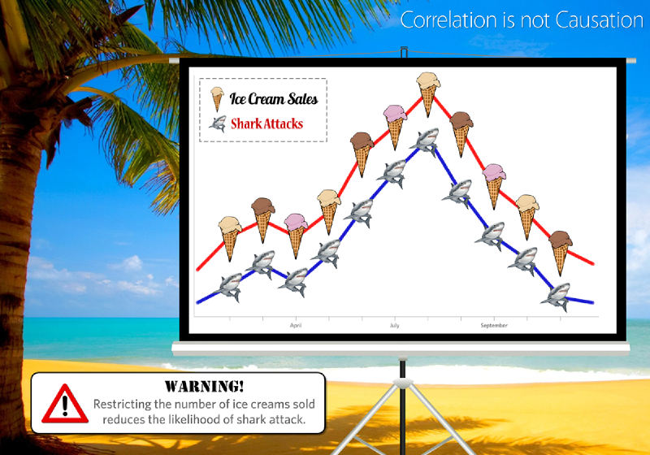
Example 2: Correlation v/s Causation

Slide 18
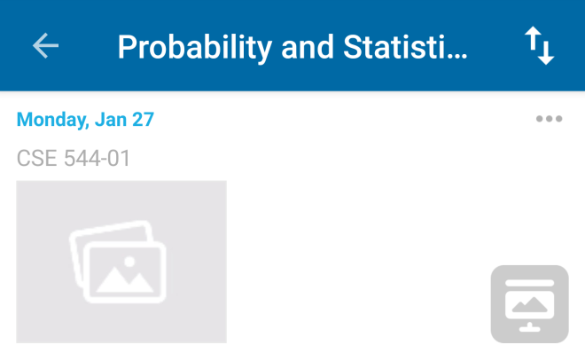
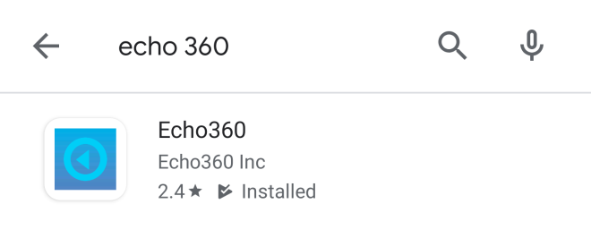
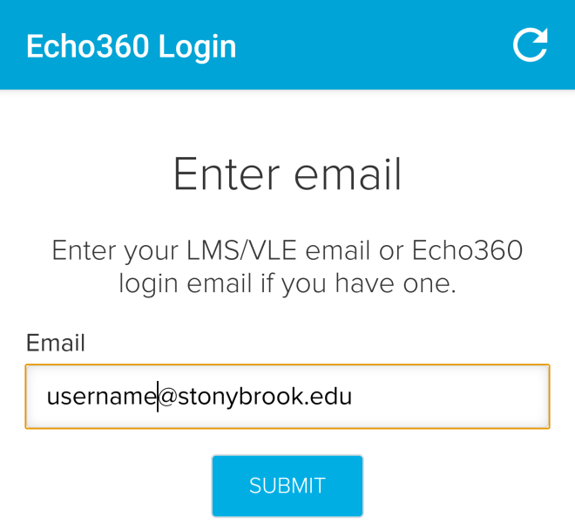
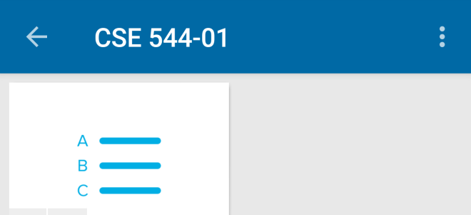
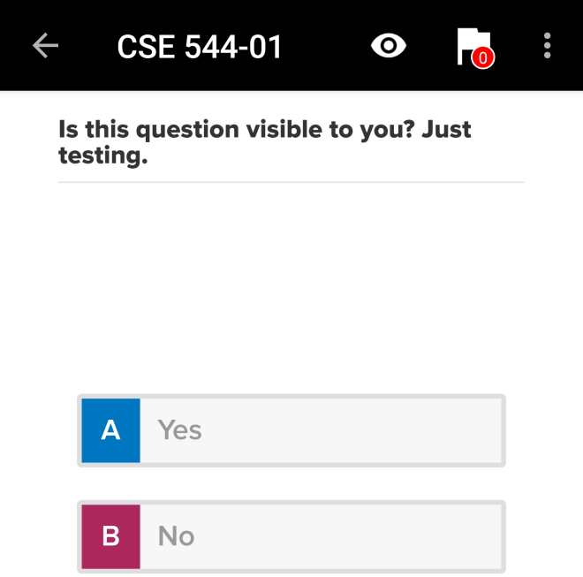
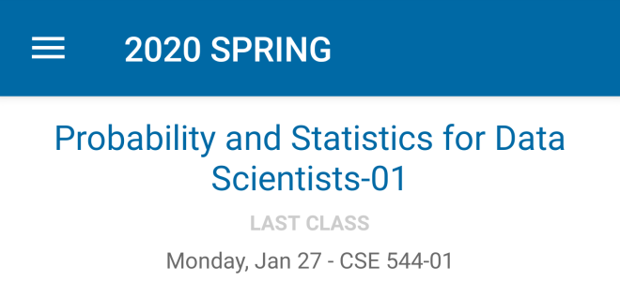
Echo360 App Testing
4)
5)
6)
1)
2)
3)
MAY HAVE TO SIGN IN TO BLACKBOARD FIRST!

Slide 19
Course webpage
www.cs.stonybrook.edu/~cse544 (will redirect)
Please bookmark this page
This is your best resource!
Will be regularly updated
Lecture slides
Assignment and exam dates
Assignment data files

Slide 20
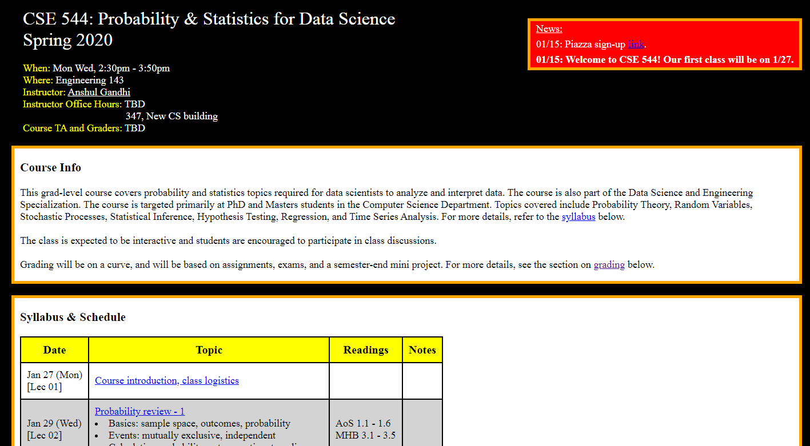
Course webpage
www.cs.stonybrook.edu/~cse544

Slide 21
Other resources
Piazza (link on website)
Can ask questions or lecture clarifications
TAs will answer, hopefully in a timely manner
Do NOT wait till the last moment
Blackboard for assignments, solutions, and grades

Slide 22


Example 3: Inspection Paradox
On average, an SBU shuttle arrives at the SAC loop every 20mins. If you show up at the SAC loop at some random time, let W be the #mins you end up waiting for a shuttle.
What is E[W]?
W
t=0
t=20

Slide 23
Example 3: Inspection Paradox
On average, an SBU shuttle arrives at the SAC loop every 20mins. If you show up at the SAC loop at some random time, let W be the #mins you end up waiting for a shuttle.
Can E[W] > 10mins?
W
t=0
t=40

Slide 24
Example 3: Inspection Paradox
On average, an SBU shuttle arrives at the SAC loop every 20mins. If you show up at the SAC loop at some random time, let W be the #mins you end up waiting for a shuttle.
Can E[W] > 20mins?
W
t=0
t=60

Slide 25
Example 3: Inspection Paradox
Students at BSU complain about large class sizes. In an unbiased sample poll of students, the average reported class size was far beyond 100. However, BSU admin swears that the average class size is less than 50. Who is lying?
10 students
10 students
CSE 544, 180 students
10 students
10 students
Avg class size = (180 + 10 + 10 + 10 + 10)/5 = 220/5 = 44 < 50
Reported average = (180*180 + 4*10*10)/220 = 149 > 100

Slide 26
Grading
45% assignments
40% exams (in-class mid-terms)
10% group mini-project
5% quizzes/attendance
Some parts are tentative!

Slide 27
Grading - assignments
45% assignments
5-6 assignments (roughly once every 1.5 weeks)
6-8 problems per assignment
Later assignments will have more programming
Collaboration is allowed (groups of 3-5 students)
One write-up per group
DO NOT COPY OR DISCUSS ACROSS GROUPS!
Try not to assign one problem per team member
If a group member is inactive, let me know asap
You can change groups, as long 3-5/group

Slide 28
Grading - assignments
Assignment questions will be based on lectures
But tougher than examples done in class
Will require some effort, helps to discuss among group
Assignments due at the beginning of class
Due date will be announced when assignment is out
NO LATE SUBMISSIONS
Hard-copies only (typed/hand-written)

Slide 29
Grading - exams
40% exams
Mid-terms 1 and 2
15% mid-term 1 (probs & stats), early March
25% mid-term 2 (inference), early May
Non-overlapping
In-class exams
Somewhat easier than assignments
Based on material/examples covered in lectures (attend!)
No collaborations, obviously
Closed-book, closed-notes
70-75 mins

Slide 30
Grading – group mini-project
10% group mini-project
Basically, assignment 7, due at end of semester
Data analysis project
Programming involved
Same as assignment group (can change if needed)
2nd half of the semester
Will discuss details as we go along

Slide 31
Grading – quizzes
5% quizzes (and attendance)
Roughly 1 per class, on average
(trying it for the first time this sem)
Very simple quiz, usually 1-2 questions max
Goal is to help you self-evaluate
And to improve class engagement (for large class)
Serves as attendance

Slide 32
Grading - recap
45% assignments
40% exams (in-class mid-terms)
10% group mini-project
5% quizzes/attendance
Some parts are tentative!
Will provide mid-sem grades (after M1)
For self-evaluation purposes only

Slide 33

Example 4: Simpson’s Paradox
☺
☹
Earns below-average income in B
Earns above-average income in A
Developed Nation (B)
Developing Nation (A)
Average income of A+B goes up!!
Average income of A goes down ☹
Average income of B goes down ☹

Slide 34
Example 4: Simpson’s Paradox
Earns below-average income in B
Earns above-average income in A
Developed Nation (B)
Developing Nation (A)
Average income of A+B Before: 160K/3 = 53.3K
After: 200K/3 = 66.7K
Person 1: 20K
Person X: 40K
Person 2: 100K
Person X: 80K

Slide 35
Example 4: Simpson’s Paradox
Since 2000, the median US wage has risen about 1% (adjusted)
But over the same period, the median wage for:
high school dropouts,
high school graduates with no college education,
people with some college education, and
people with Bachelor’s or higher degrees
have all decreased. In other words, within every educational subgroup, the median wage is lower now than it was in 2000.
How can both things be true??

Slide 36
Syllabus
Probability Theory (8-10 lectures, 2 assignments)
Probability review (events, computing probability, conditional prob., Bayes’ thm.)
Random variables (Geometric, Exponential, Normal, expectation, moments, etc.)
Probability inequalities (Markov’s, Chebyshev’s, Central Limit thm., etc.)
Markov chains (stochastic processes, balance equations, etc.)
MID-TERM 1 (Early March)
Statistical Inference (8-10 lectures , 3 assignments)
Non-parametric inference (empirical PDF, bias, kernel density, plug-in estimator)
Confidence intervals (percentiles, Normal-based CIs)
Parametric inference (method of moments, max likelihood estimator)
Hypothesis testing (Wald’s test, t-test, KS test, p-values, permutation test)
Bayesian inference (Bayesian reasoning, inference, etc.)
Data Science Models (3-5 lectures, 1 assignment)
Regression (simple LR, multiple LR, non-linear regression)
Time series analysis (moving average, EWMA, AR, ARMA, ARIMA)
MID-TERM 2 (Early May)
MINI-PROJECT (Early May)

Slide 37
Syllabus
www.cs.stonybrook.edu/~cse544

Slide 38
Next class
Probability review - 1
Basics: sample space, outcomes, probability
Events: mutually exclusive, independent
Calculating probability: sets, counting, tree diagram

